Slide 1
Ethan Smith
Site reliability engineer

Slide 2
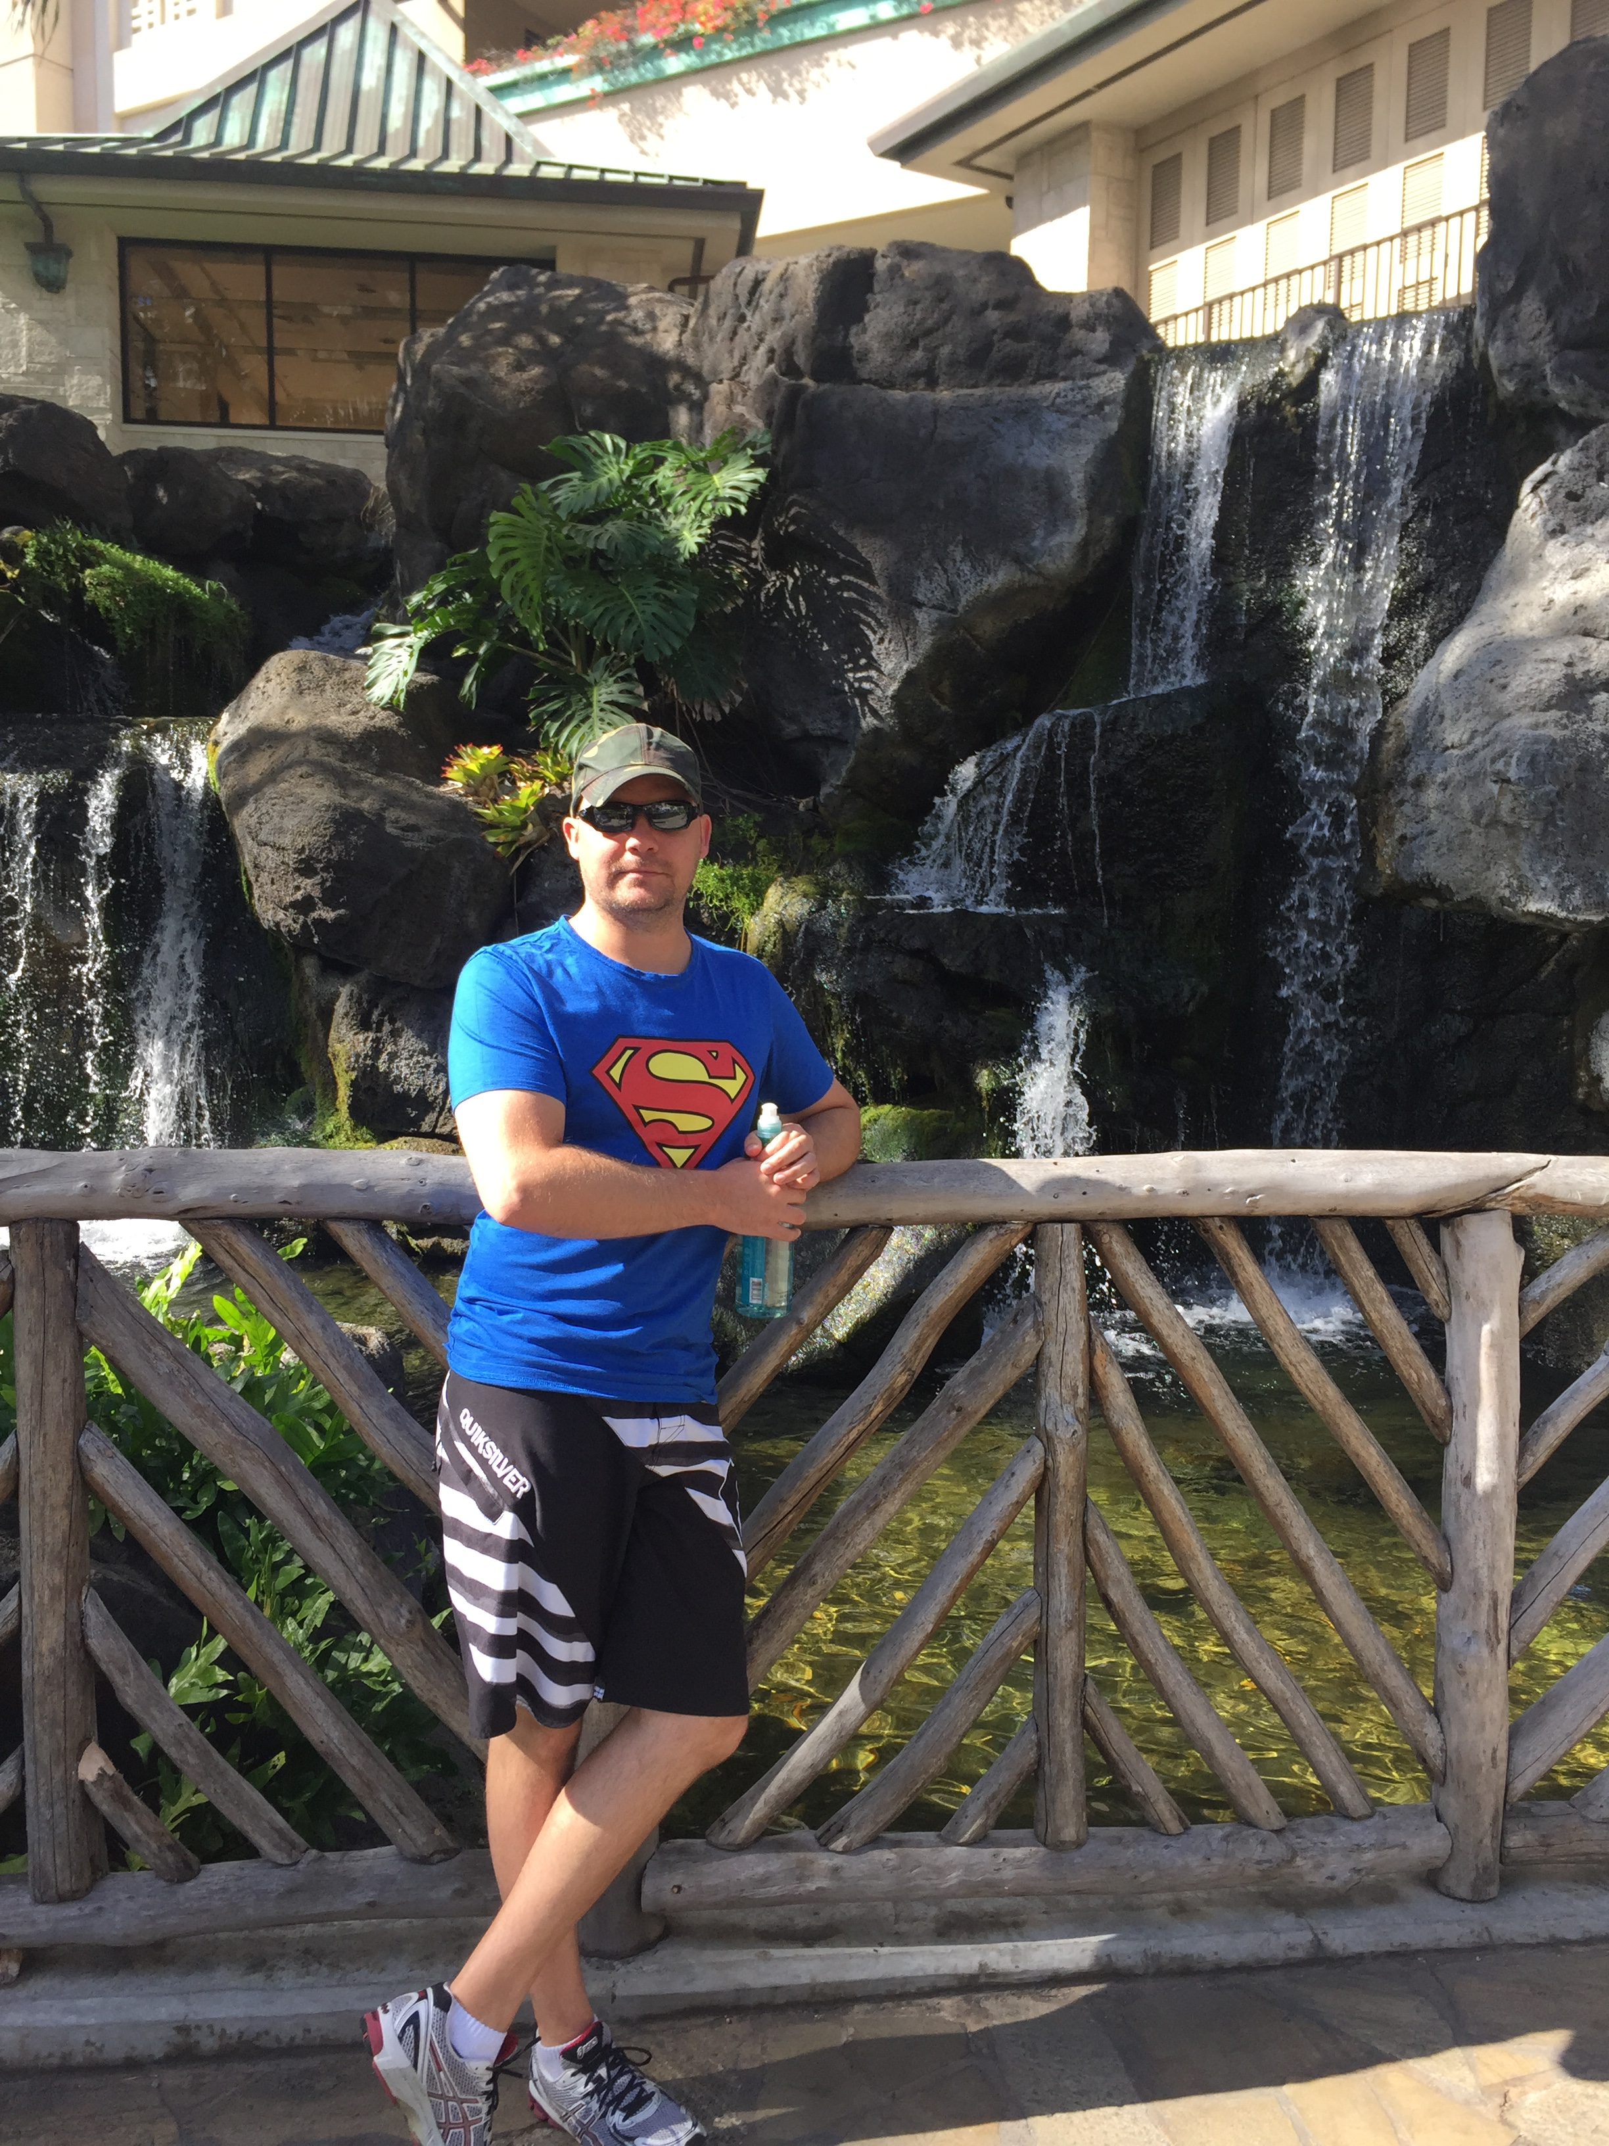
About me
Born in Zimbabwe.
Named Aubrey, but changed name to Ethan 2020.
Been in NZ 20 years this year.
Consider myself a Cantabrian.

Slide 3
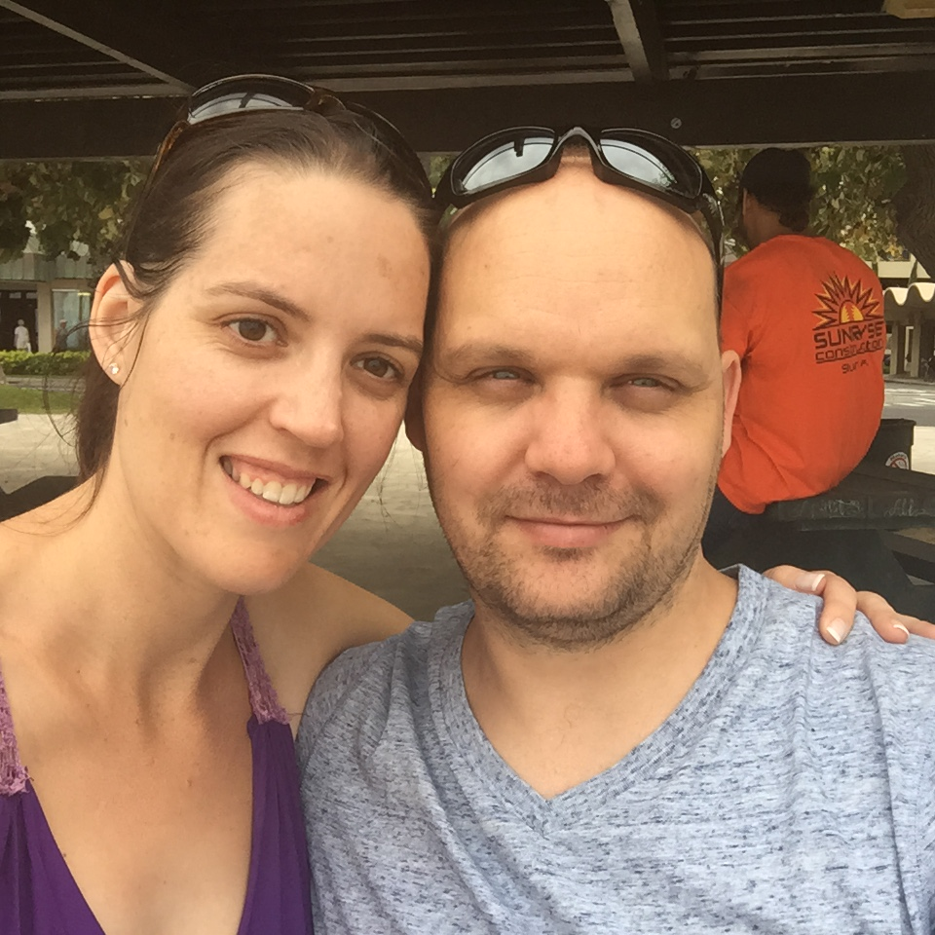

Family
Wife Rosemary – met working in Funds at ANZ.
Son Oliver – 8 years old.
Daughter Isabelle – 7 years old.

Slide 4
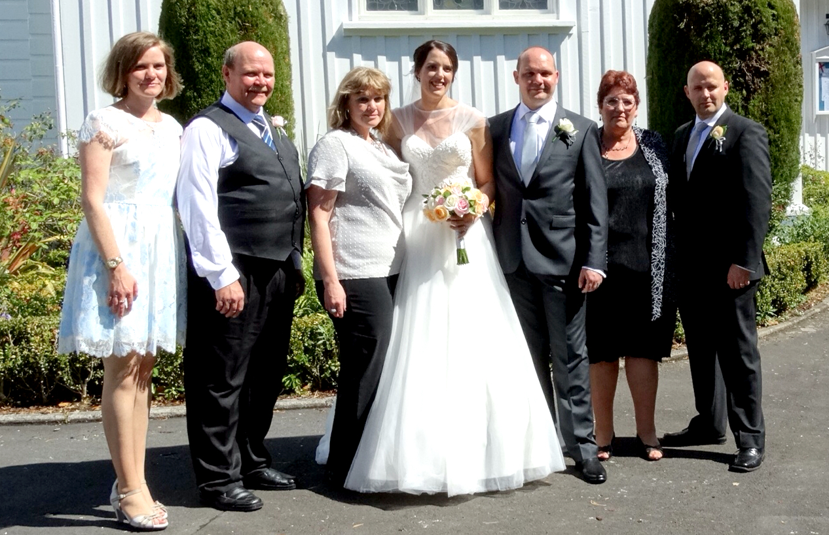
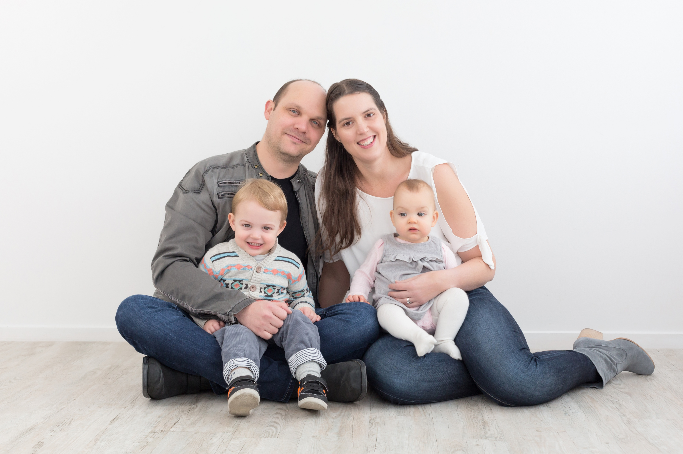
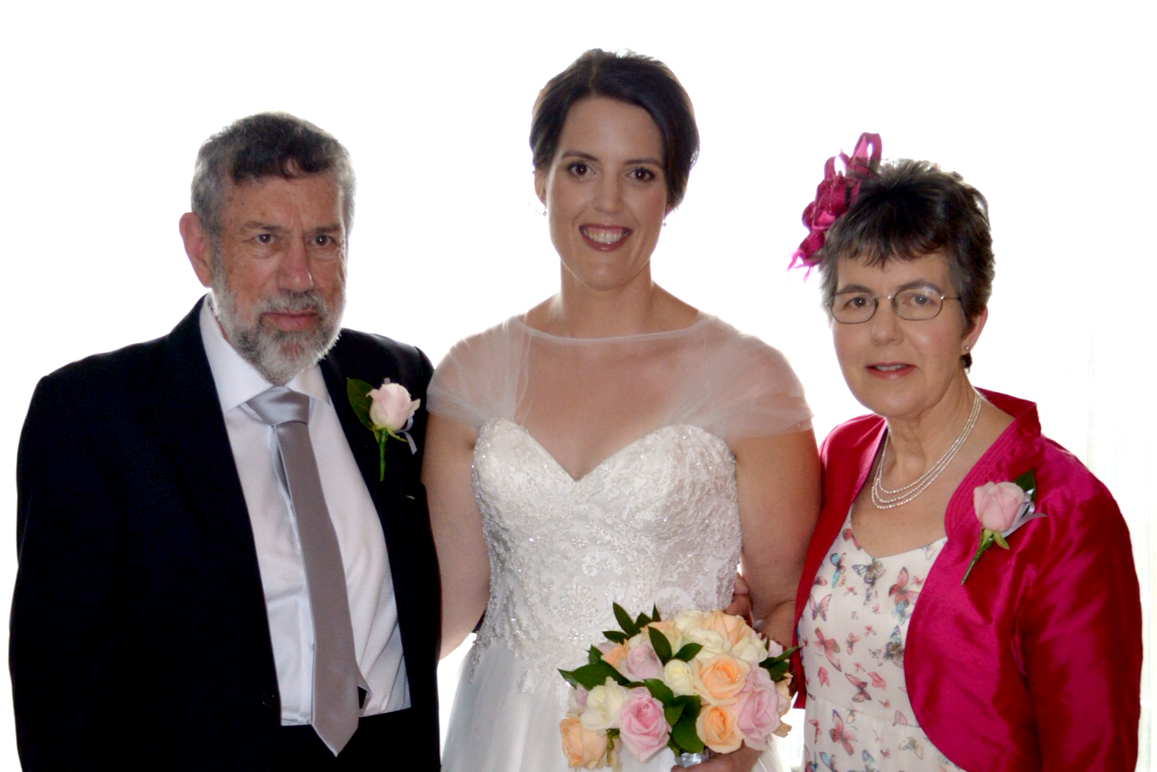

Slide 5
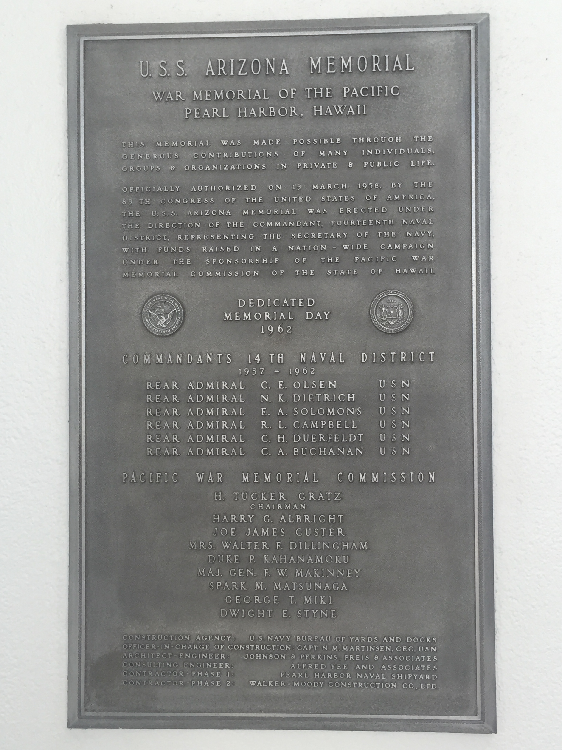
Hobbies & interests
LEGO.
Military Wargaming.
Military history.
Technology.
Gaming.

Slide 6
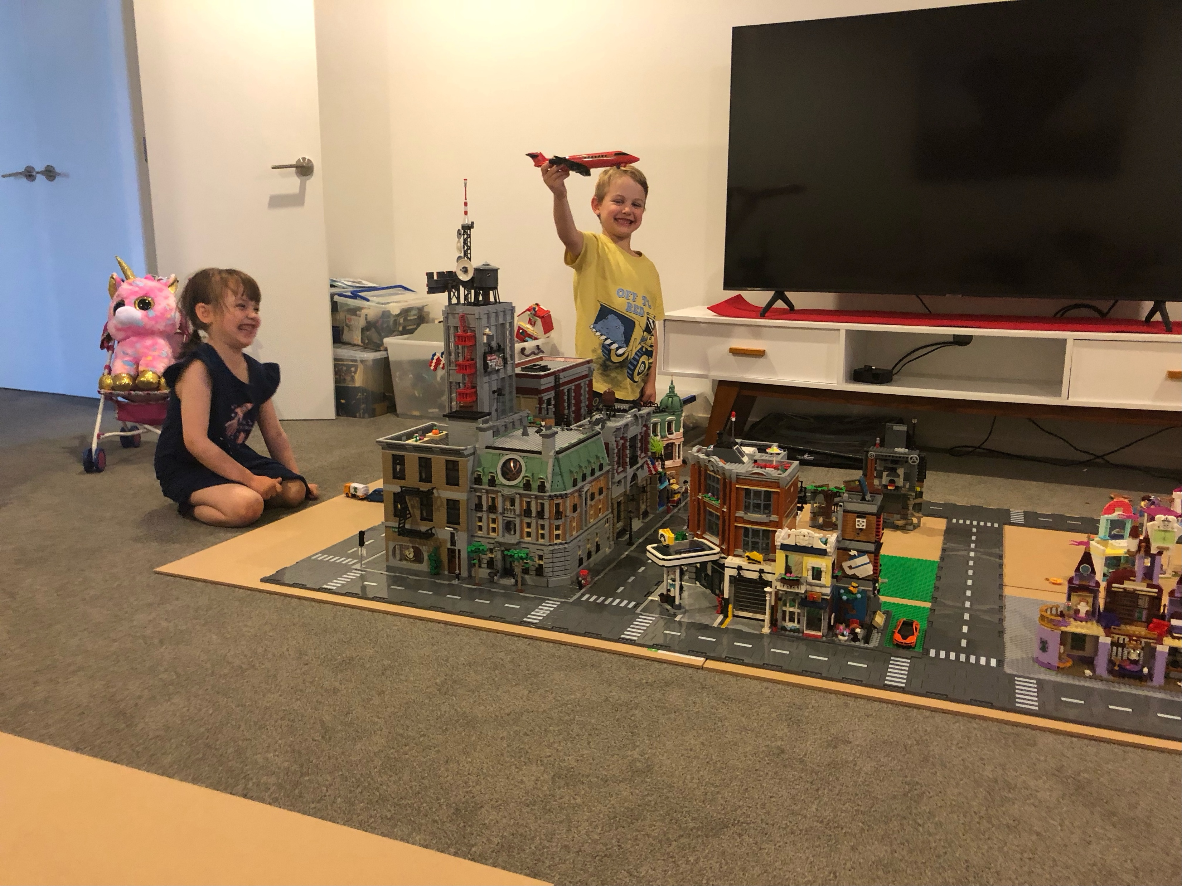
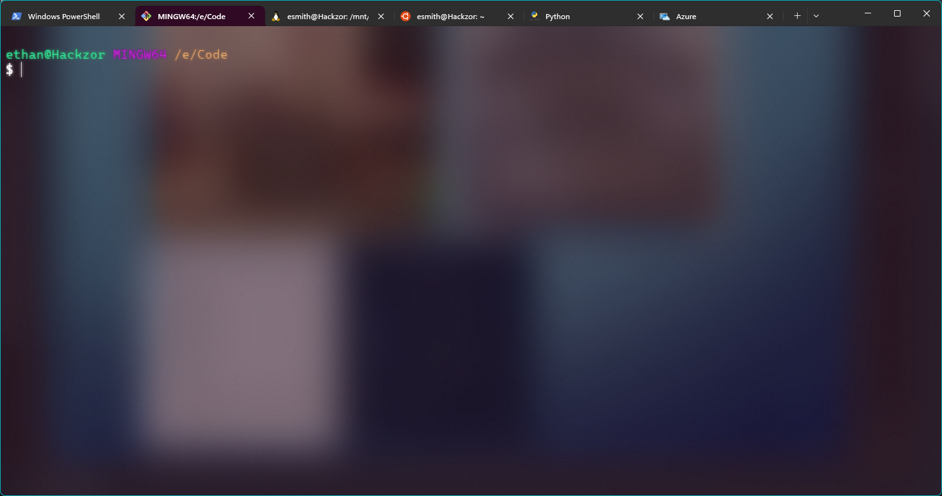
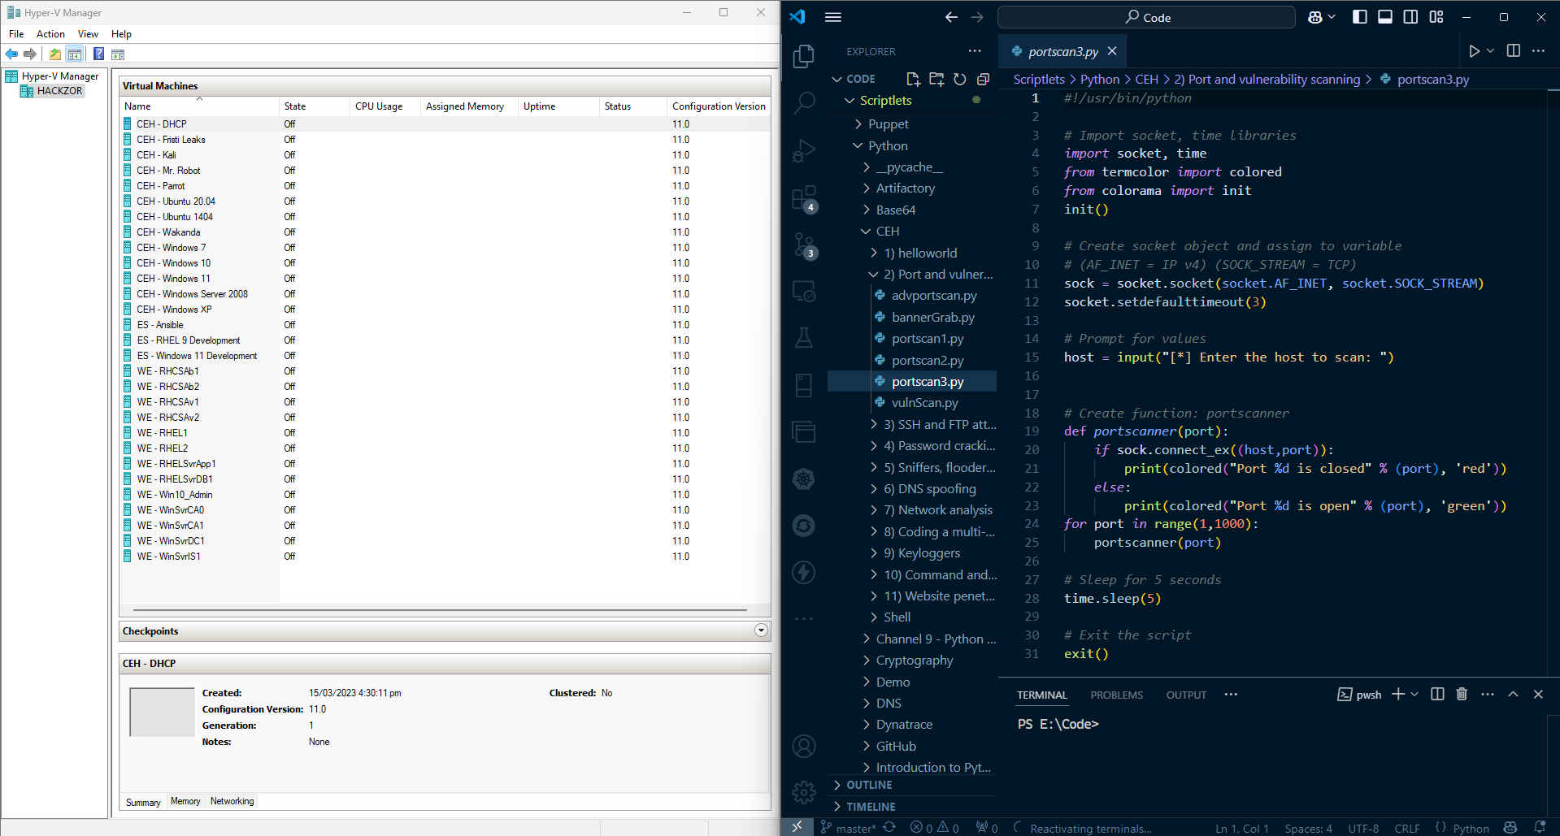
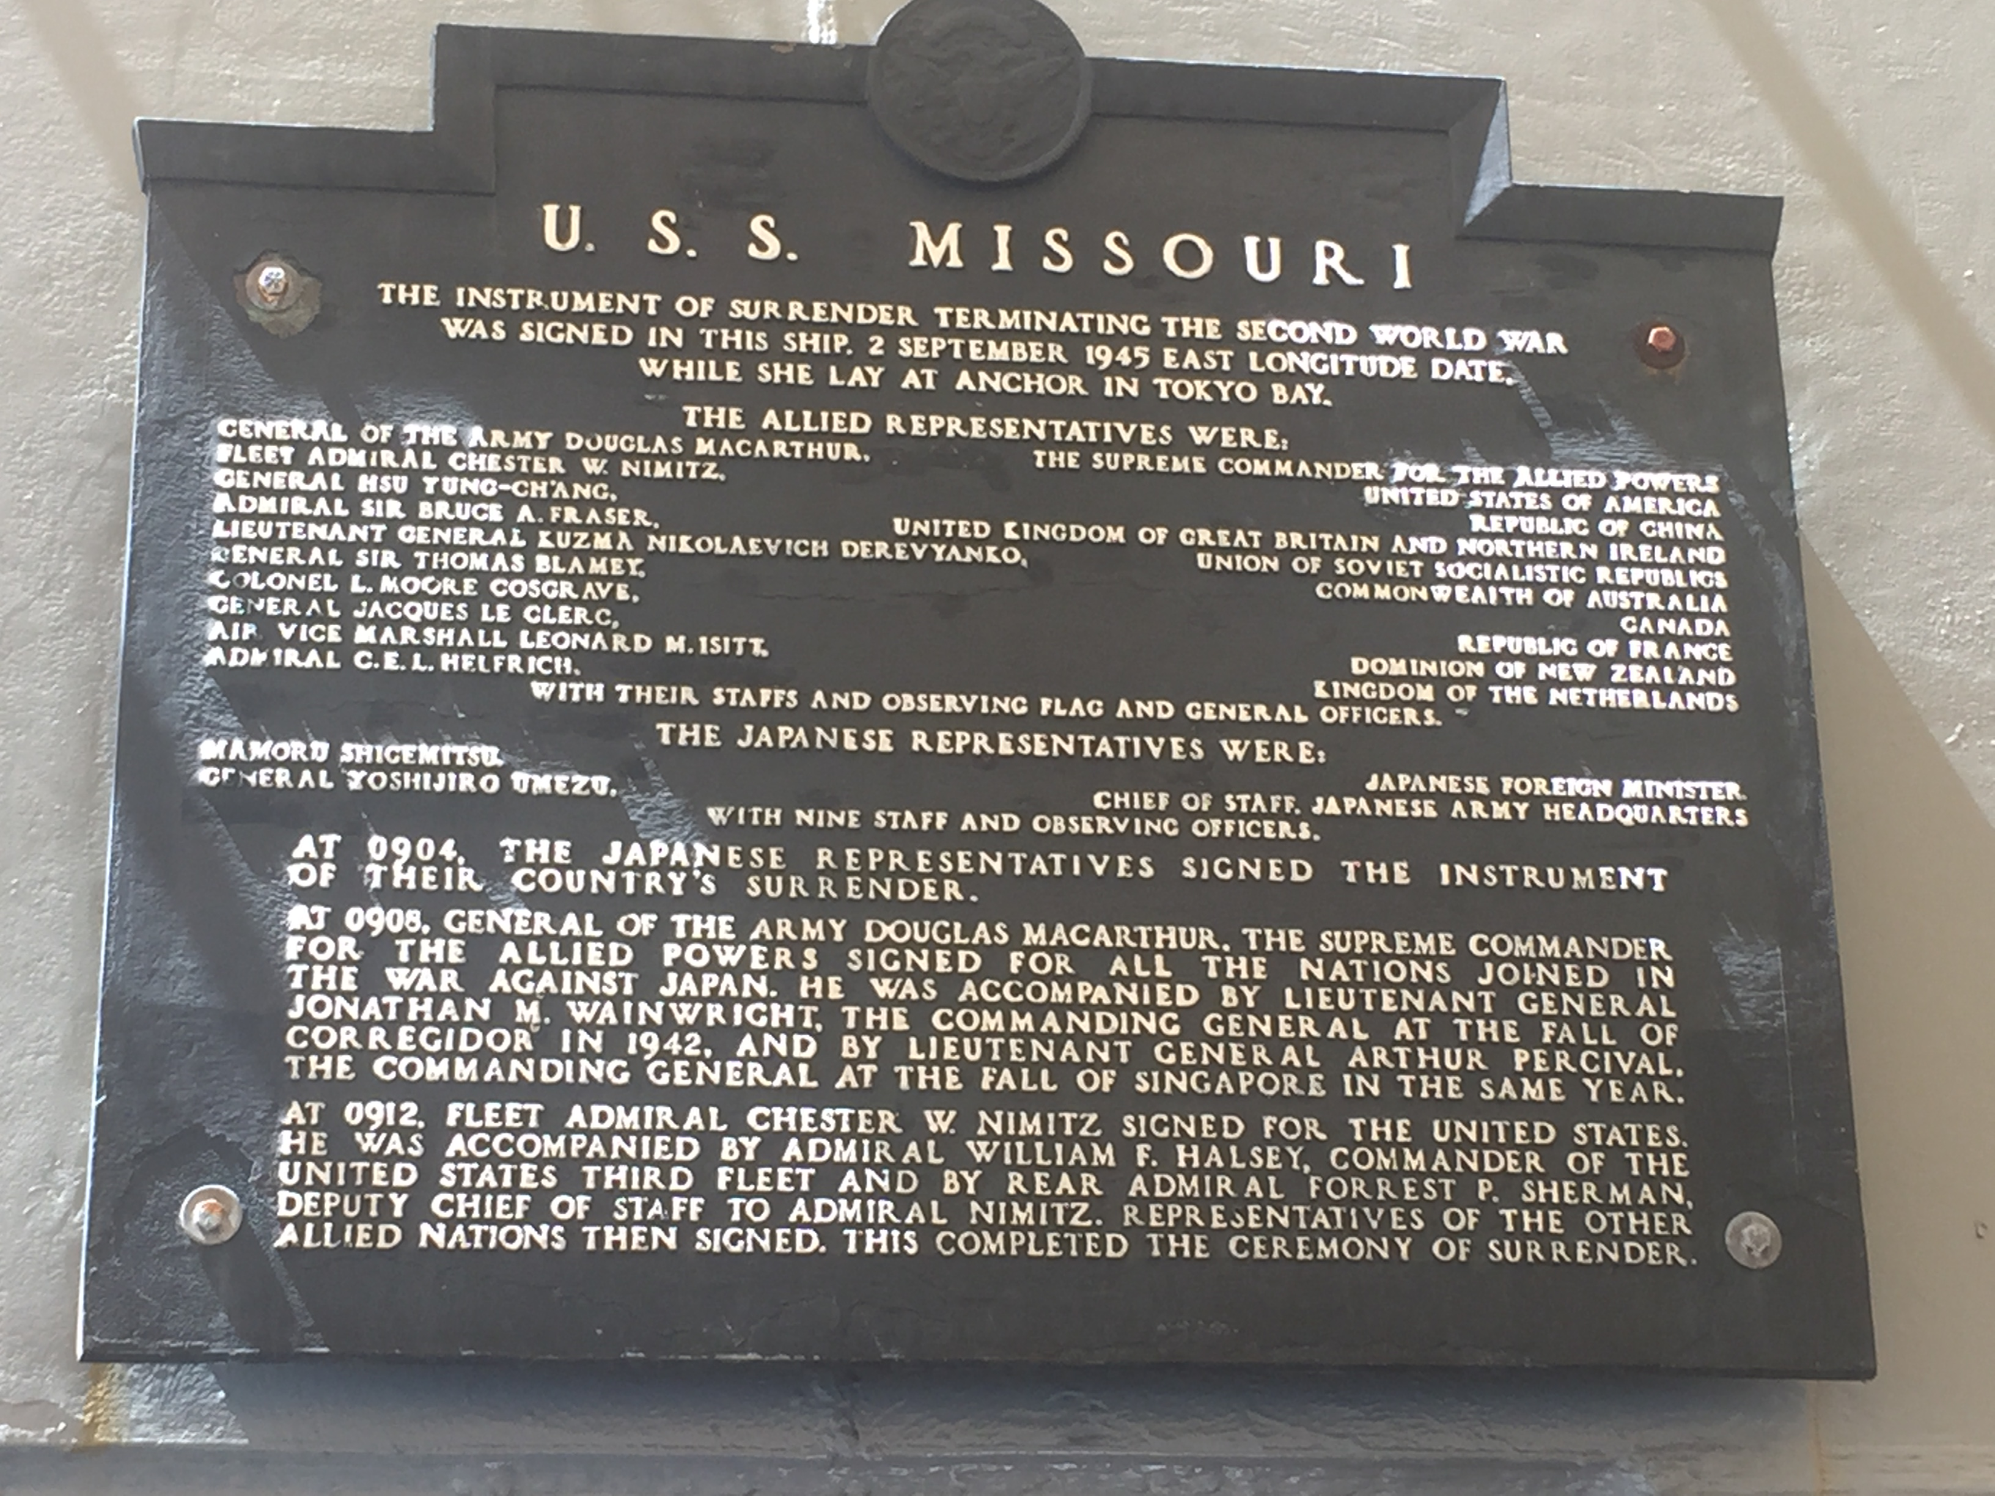

Slide 7
Career @ ANZ
Started in Funds November 2006 (ING Life).
Redundant Sept 2009.
Returned to Funds April 2010.
Moved into Delivery Services 2015, then restructured into Operational Tools and Services, Tooling team.
Returned to Funds 2023.

Slide 8
Roles @ ANZ
Service Desk.
Application Support.
Wintel in delivery services.
Tooling Specialist.
Senior System Engineer.

Slide 9
Strengths
T-shaped technologist – I am constantly playing with new technologies and ideas.
Logical thinker – I visualise infrastructure in my mind, this helps me follow traffic through the network which aids me in troubleshooting.
Problem solving – understanding technology helps me fix it and find gaps.
Thinking outside the box – IBM monitoring failing, use ping.
HFA (Aspergers) – I don’t think the same as Nuero-typical people which often provides a fresh perspective.
Friendly and helpful. Mantra - never be the reason for someone else’s bad day.
Work best when under pressure.

Slide 10
Weaknesses
HFA – Sensory overload in loud and busy places such as airports. Airports, shopping malls and even busy offices are exhausting and can lead to crippling migraines with over exposure.
Social skills:
- Social norms such as maintaining eye contact is extremely tiring and can leave me feeling overwhelmed. Also, I don’t always know when I can speak.
- I have to apply multiple filters before I communicate, this is not necessarily a weakness, but I am constantly mindful of it.

Slide 11
GitHub Enterprise cloud enablement
The problem:
It was discovered that the GitHub Enterprise infrastructure in NZ was not BS11 compliant at the start of March in 2023. This was due to an architectural oversight during initial infrastructure design.
Reportable breach to RBNZ if not resolved before the end of March.

Slide 12
Actions
Immediately requested AD objects that could be provisioned in advance.
Engaged networks to create new DNS zone and record that was required in NZ InfoBlox. They were apprehensive until I explained that the certificate is bound to a namespace, and NZ was not authoritative for current zone – only group.
Engaged AU networks to create forwarding rule for DNS zone.
Engaged security to create proxy-bypass rule for new zone.
External certificate issued to new created DNS name.
Deployed new appliances under a change. The primary appliance failed during the change deployment. I invoked DR during the change and completed change successfully.

Slide 13
Result
The BS11 GitHub environment was stood up and operational with three days to spare. It took 26 days to deliver from drawing board to production.
Primary appliance was rebuilt and deployed as part of the change as the replica.
Due to deploying to DR, we were DR compliant from going-live. No post-deployment DR test required, just restoration. Which was completed over the following weeks.

Slide 14
Delivering value
Introduced team to source control – moved away from Confluence for storing scripts and code.
Introduced Artifactory.
Had team enrolled in Red Hat Learning Subscription program.
Created team tools manifest.
Automating toil – deliver value.
Monitoring.
BDDs – risk in event of Ransomware attack.

